Slide 1
Introduction to data analysis and BI
Pr. Abdessamad BENLAHBIB
FSDM

Slide 2
Outline
What is a Data Analysis Workflow?
Steps in a Data Analysis Workflow
What is Business Intelligence?
How does BI work?
Business Intelligence vs Data Analysis
Python and Pandas for Data Cleaning and Preparation
Power BI Desktop for Reporting
Setting Up Your Toolkit: Installing Python, Pandas, Jupyter Notebook and Power BI

Slide 3
What is a Data Analysis Workflow?
A data analysis workflow is a step-by-step process that guides the analysis of data. It provides a structured approach to data analysis, ensuring that the process is systematic, and repeatable. The workflow typically includes several stages, each with its own set of tasks and objectives.
The first stage in the workflow is defining the question or problem. This involves understanding the context of the analysis, the goals of the project, and the questions that need to be answered. This stage sets the direction for the entire analysis and is crucial for ensuring that the results are relevant and actionable.

Slide 4
Steps in a Data Analysis Workflow
The data analysis workflow consists of several steps, each with its own set of tasks and objectives. While the specific steps can vary depending on the nature of the project and the data at hand, a typical workflow includes the following stages:
Defining the Question: This is the first and arguably the most important step in the workflow. It involves identifying the problem or question that the analysis aims to answer. This step sets the direction for the entire analysis and ensures that the results are relevant and actionable.
Data Collection: Once the question has been defined, the next step is to collect the data needed to answer it. This can involve gathering existing data or generating new data through surveys, experiments, or other methods.

Slide 5
Steps in a Data Analysis Workflow
Data Cleaning and Preparation: After the data has been collected, it needs to be cleaned and prepared for analysis. This involves removing errors, handling missing values, and transforming the data into a suitable format for analysis.
Data Analysis: With the data cleaned and prepared, the next step is to analyze it. This involves applying statistical techniques, machine learning algorithms, or other methods to uncover patterns, relationships, and insights in the data.
Interpretation and Reporting: The final step in the workflow is to interpret the results of the analysis and report them in a clear and understandable way. This involves creating visualizations, writing reports, and presenting the findings to stakeholders.

Slide 6
What is business intelligence?
Business intelligence combines business analytics, data mining, data visualization, data tools and infrastructure, and best practices to help organizations make more data-driven decisions. In practice, you know you’ve got modern business intelligence when you have a comprehensive view of your organization’s data and use that data to drive change, eliminate inefficiencies, and quickly adapt to market or supply changes.
Business intelligence (BI) refers to capabilities that enable organizations to make better decisions, take informed actions, and implement more-efficient business processes.

Slide 7
How business intelligence works?
Businesses and organizations have questions and goals. To answer these questions and track performance against these goals, they gather the necessary data, analyze it, and determine which actions to take to reach their goals.
On the technical side, raw data is collected from business systems. Data is processed and then stored in data warehouses, the cloud, applications, and files. Once it’s stored, users can access the data, starting the analysis process to answer business questions.
BI platforms also offer data visualization tools, which convert data into charts or graphs, as well as presenting to any key stakeholders or decision-makers.

Slide 8
business intelligence VS Data analysis
Data Analysis and Business Intelligence (BI) are closely related fields, but they have distinct differences:
Scope:
Data Analysis: Primarily focuses on examining data to extract insights, identify trends, and make conclusions. It involves processing, cleaning, and analyzing raw data to discover patterns and relationships.
Business Intelligence: Encompasses a broader set of activities, including data analysis, but with a focus on providing actionable insights to support decision-making in business operations. BI involves not only analyzing data but also transforming it into meaningful and useful information for strategic planning and operational improvements.

Slide 9
business intelligence VS Data analysis
2. Purpose:
Data Analysis: Aims to understand data characteristics, uncover patterns, and provide explanations for observed phenomena. It often involves descriptive and exploratory analysis.
Business Intelligence: Aims to empower businesses with insights derived from data to enhance decision-making processes. BI solutions often involve creating dashboards, reports, and data visualizations that offer insights into various aspects of business operations.

Slide 10
business intelligence VS Data analysis
3. Users:
Data Analysis: Typically performed by data analysts, data scientists, or researchers who possess strong quantitative and analytical skills. They focus on understanding data at a detailed level.
Business Intelligence: Used by a broader range of stakeholders within an organization, including executives, managers, and operational staff. BI tools are designed to be user-friendly and accessible to individuals who may not have specialized analytical skills.

Slide 11
business intelligence VS Data analysis
4. Time Horizon:
Data Analysis: Often focuses on historical data to understand past trends and behaviors.
Business Intelligence: While historical data is important, BI also emphasizes real-time or near-real-time analysis to support operational decision-making and ongoing monitoring of key performance indicators (KPIs).

Slide 12
business intelligence VS Data analysis
5. Tools and Technologies:
Data Analysis: Involves a variety of tools and techniques such as statistical analysis, data mining, and machine learning algorithms. Programming languages like Python and R are commonly used.
Business Intelligence: Relies on specialized BI platforms and tools such as Tableau, Power BI, and QlikView. These tools often offer features for data visualization, and interactive dashboards.

Slide 13
business intelligence VS Data analysis
In summary, while data analysis is a component of business intelligence, BI encompasses a broader set of activities aimed at providing actionable insights to support strategic and operational decision-making within organizations.
In essence:
BI can be seen as providing the "what“, "how“ and “why” of business performance.
Data Analysis can be seen as providing the "what next."

Slide 14

Python and Pandas for Data Cleaning and Preparation
Pandas is a Python library used for working with data sets.
It has functions for analyzing, cleaning, exploring, and manipulating data.
The name "Pandas" has a reference to both "Panel Data", and "Python Data Analysis" and was created by Wes McKinney in 2008.

Slide 15
Python and Pandas for Data Cleaning and Preparation
Pandas allows us to analyze big data and make conclusions based on statistical theories.
Pandas can clean messy data sets, and make them readable and relevant.
Relevant data is very important in data science.

Slide 16
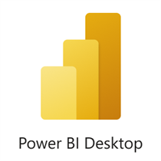
Power BI Desktop for Reporting
Power BI Desktop is a free application you install on your local computer that lets you connect to, transform, and visualize your data. With Power BI Desktop, you can connect to multiple different sources of data, and combine them (often called modeling) into a data model. This data model lets you build visuals, and collections of visuals you can share as reports, with other people inside your organization.

Slide 17
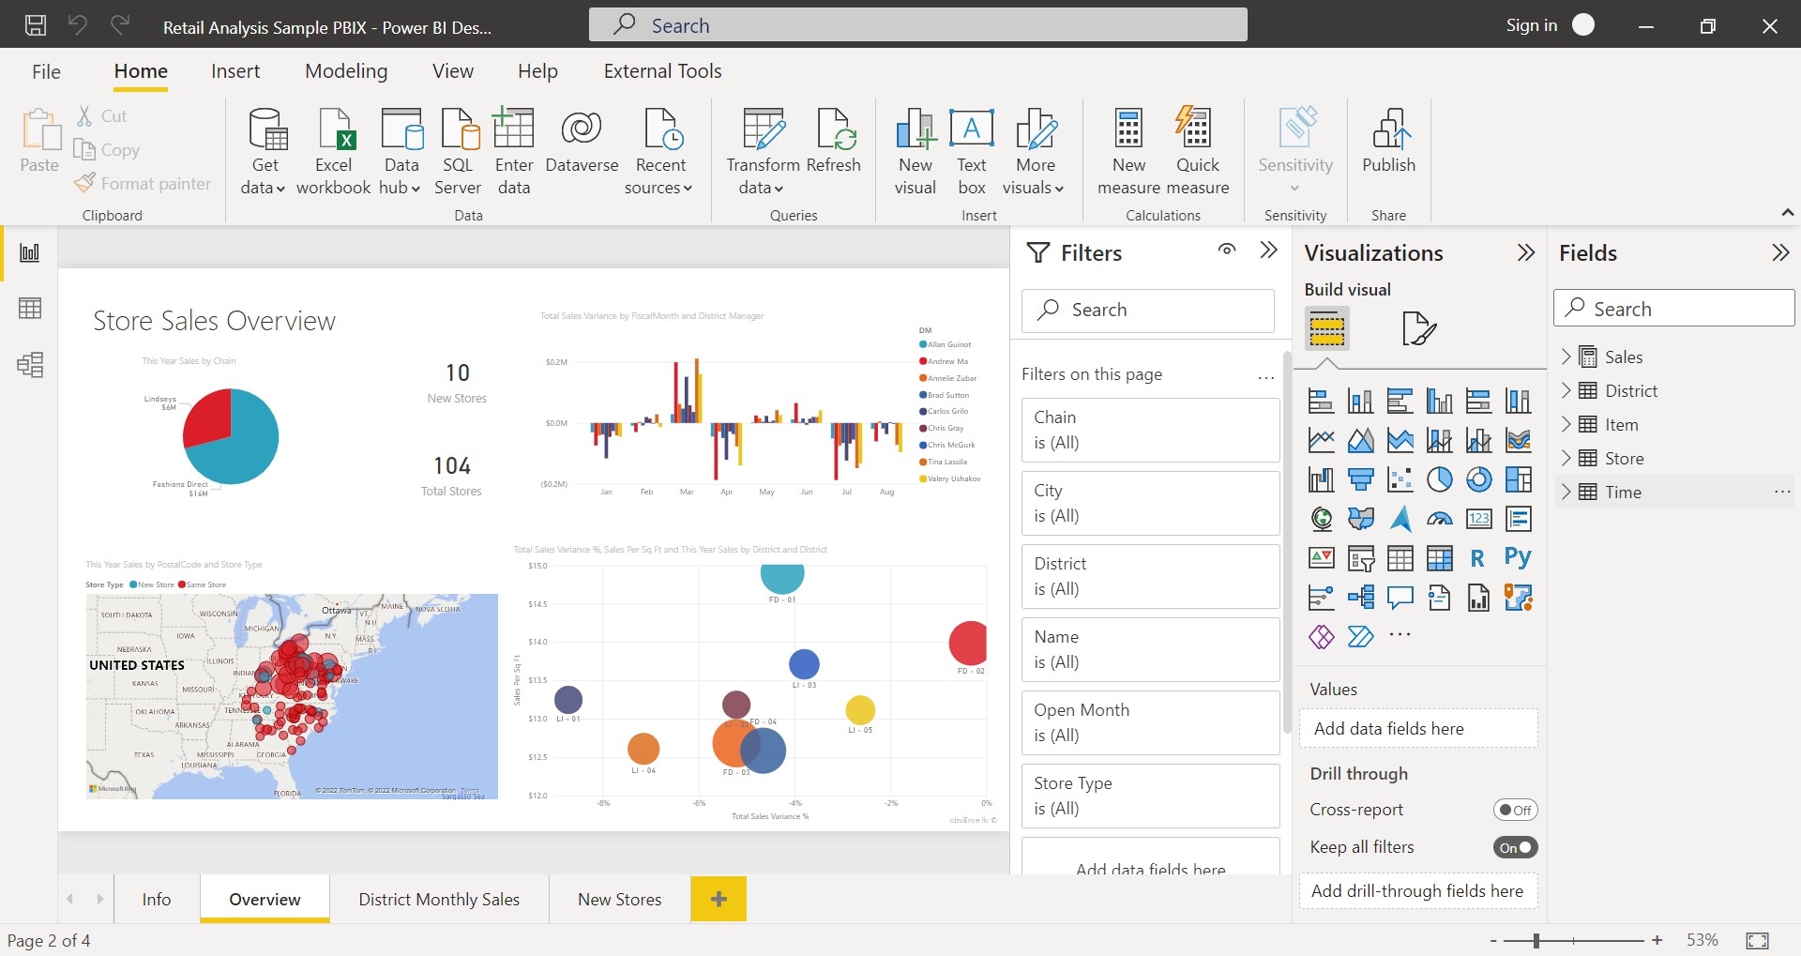
Power BI Desktop for Reporting

Slide 18
Power BI Desktop for Reporting
The most common uses for Power BI Desktop are as follows:
Connect to data.
Transform and clean data to create a data model.
Create visuals, such as charts or graphs that provide visual representations of the data.
Create reports that are collections of visuals on one or more report pages.
Share reports with others by using the Power BI service.

Slide 19
Power BI Desktop for Reporting
People who are responsible for such tasks are often considered data analysts (sometimes referred to as analysts) or business intelligence professionals (often referred to as report creators). Many people who don't consider themselves an analyst or a report creator use Power BI Desktop to create compelling reports, or to pull data from various sources. They can build data models, and then share the reports with their coworkers and organizations.

Slide 20
Power BI Desktop for Reporting
Power BI Desktop is updated and released on a monthly basis, incorporating customer feedback and new features. Only the most recent version of Power BI Desktop is supported; customers who contact support for Power BI Desktop will be asked to upgrade to the most recent version. You can get the most recent version of Power BI Desktop from the Windows Store, or as a single executable containing all supported languages that you download and install on your computer.
https://aka.ms/pbidesktopstore
https://www.microsoft.com/download/details.aspx?id=58494

Slide 21


Setting Up Your Toolkit: Installing Python, Pandas, Jupyter Notebook and Power BI

